Slide 1
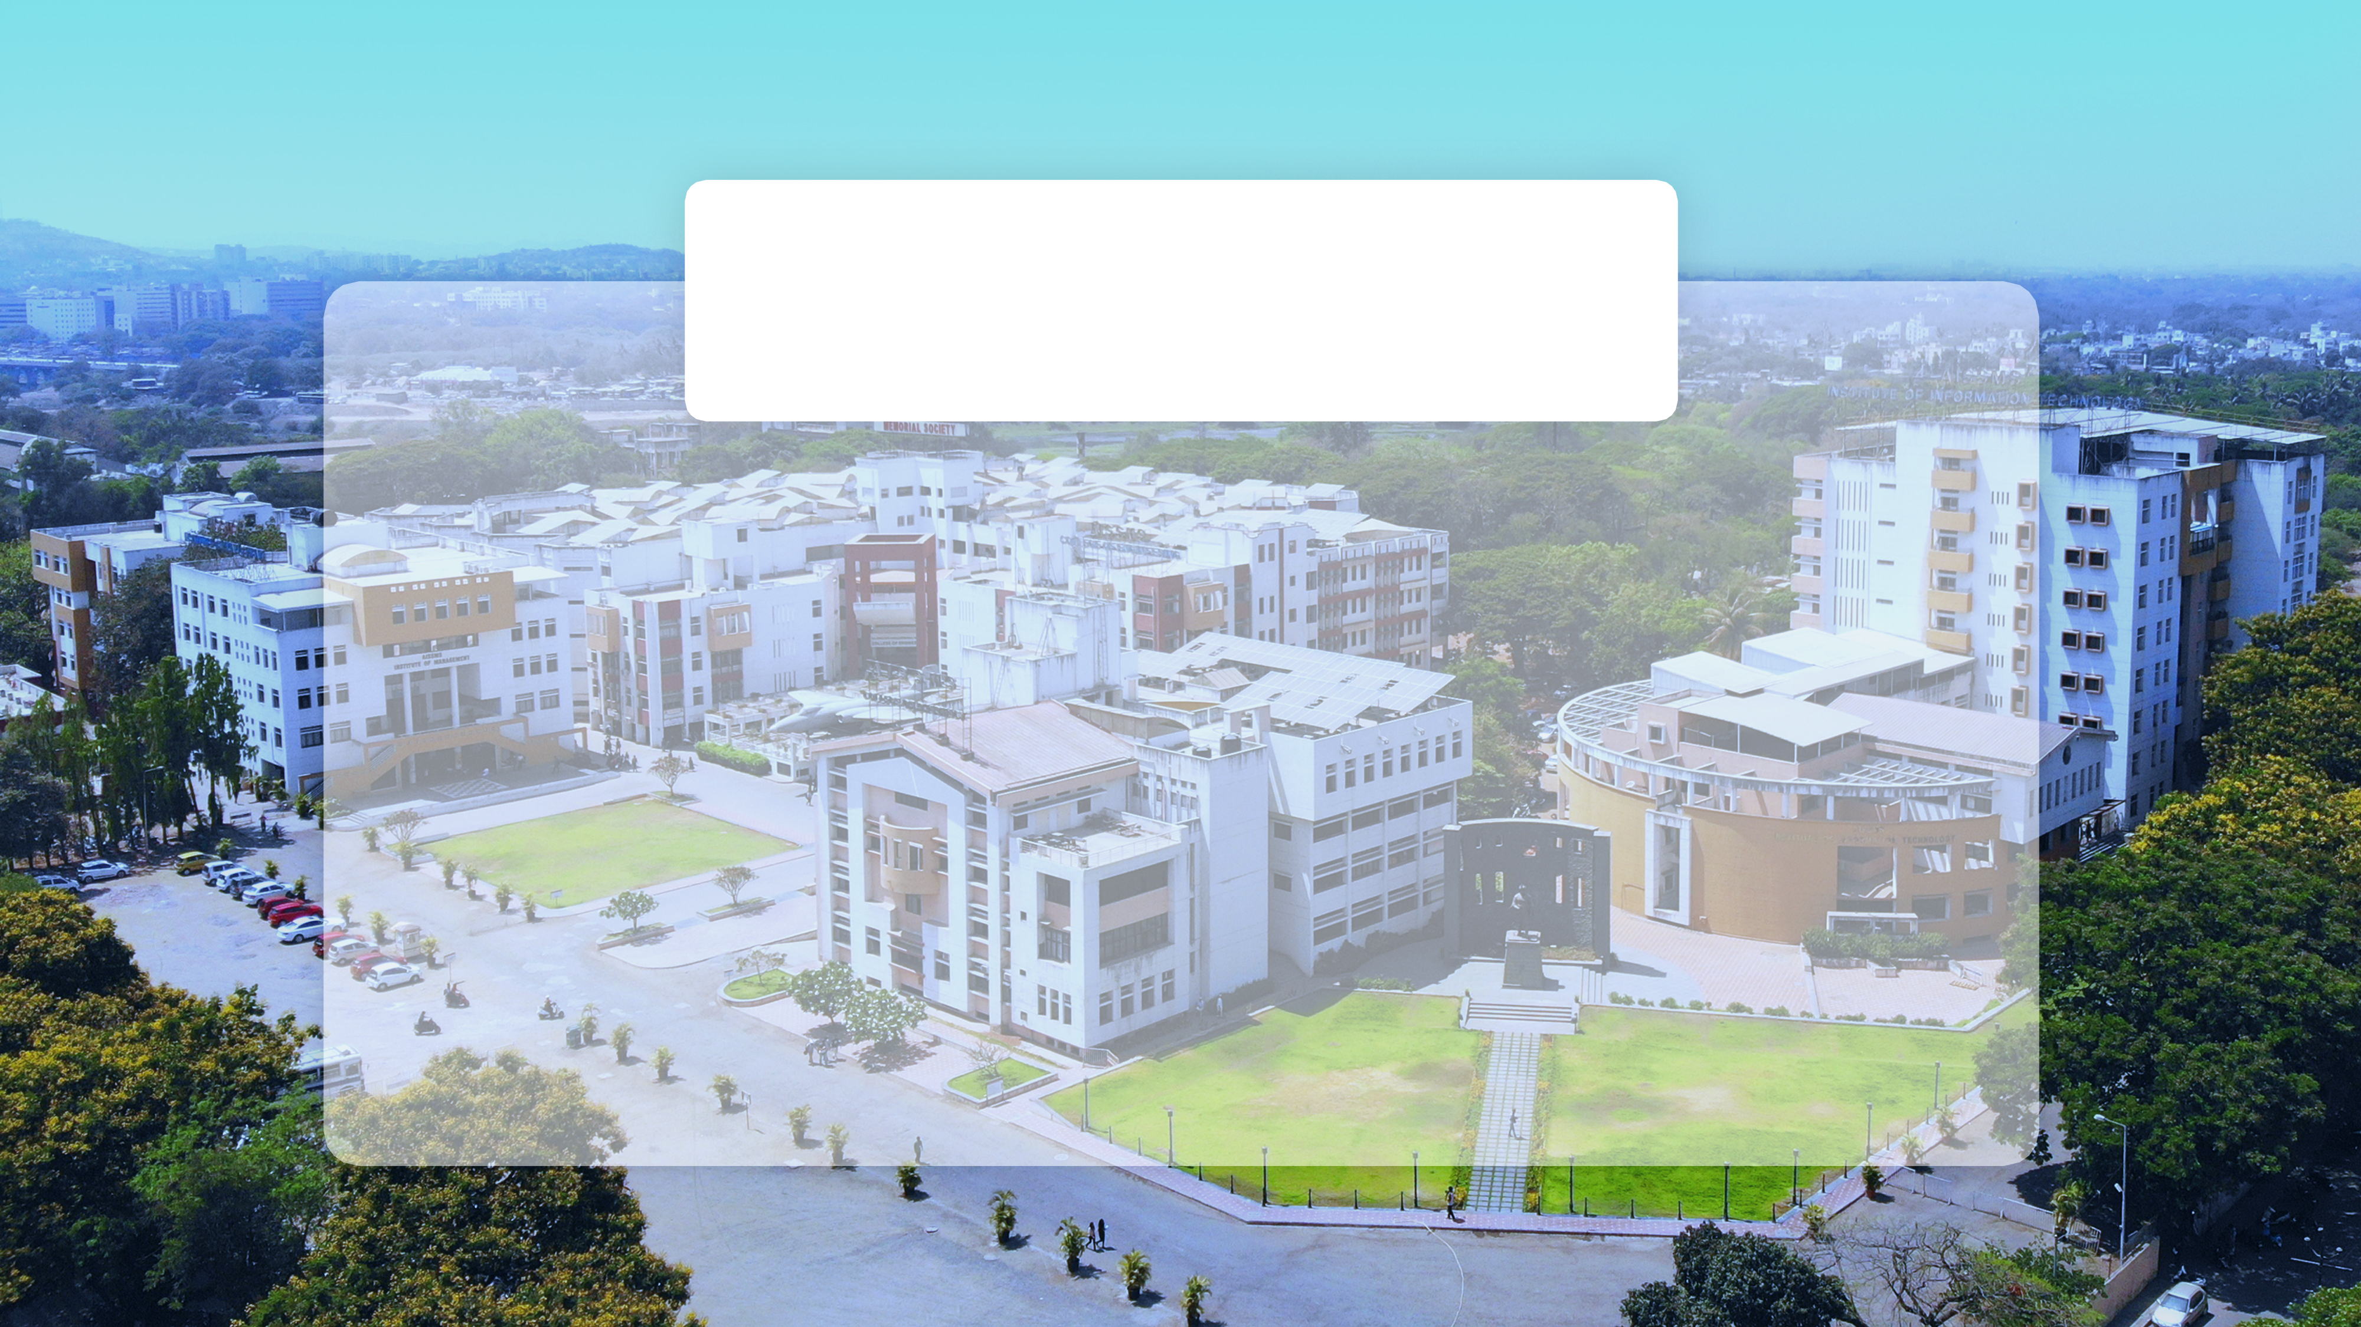

Scada Design for Process Parameter
Group No: 08

Slide 2
Introduction
In today's rapidly evolving industrial and agricultural sectors, the need for automation, precision control, and real-time monitoring has become more critical than ever. The “Scada Design for Process Parameter” is designed as a compact, integrated training and testing platform that simulates real-world industrial process control systems. It enables users to monitor and control vital parameters such as flow rate, liquid level, temperature, and pressure, making it highly applicable in industries like water treatment, chemical processing, and modern agricultural systems.
With increasing demand for process reliability and equipment protection, especially in resource-critical environments like agriculture, Scada Design for Process Parameter serves both as an educational tool and a practical prototype. It enables real-time fault detection, such as overpressure, overflow, under-voltage, or abnormal flow conditions, and takes appropriate control actions to maintain safe and optimal operation.

Slide 3
Methodology
SYSTEM DESIGN
Process Parameter monitoring and control
PLC and SCADA Integration
2. PROJECT PLANNING
Define Objectives and Requirements
Select Components
Programming
Integration and Deployment

Slide 4
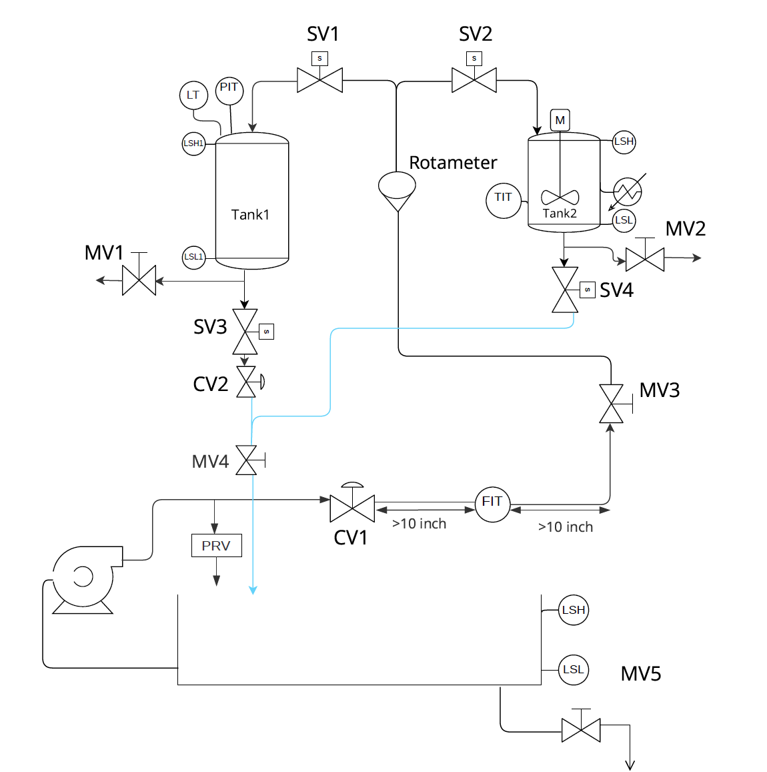
Design of System

Slide 5
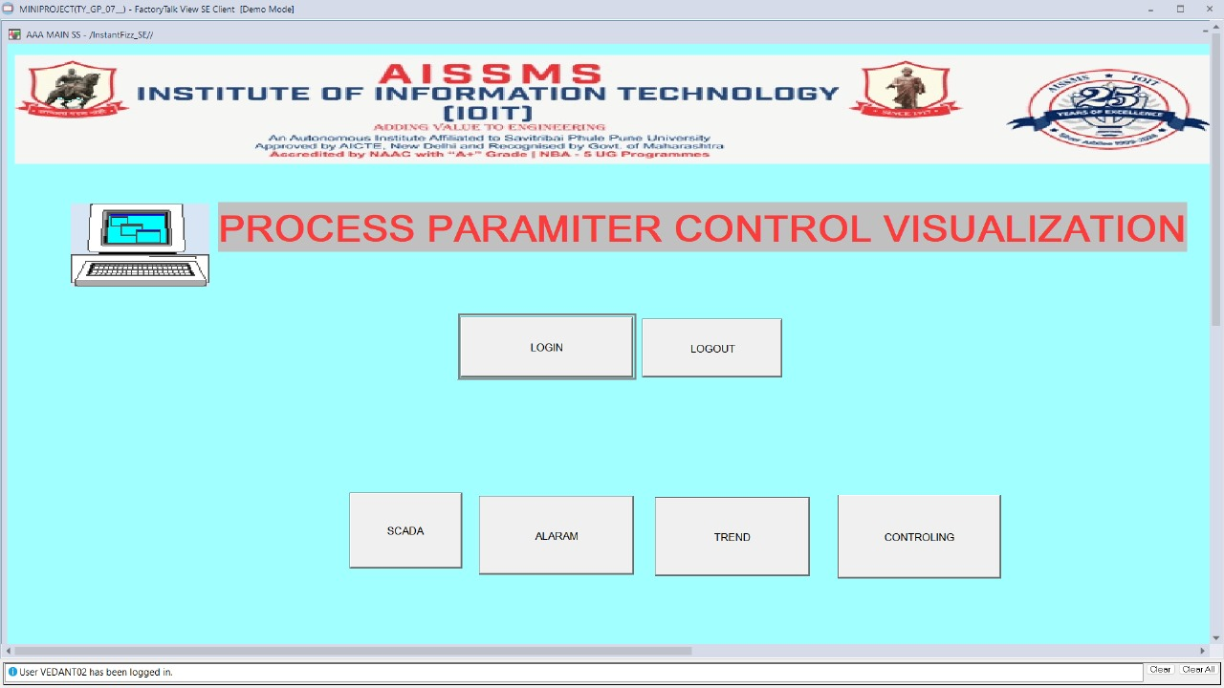
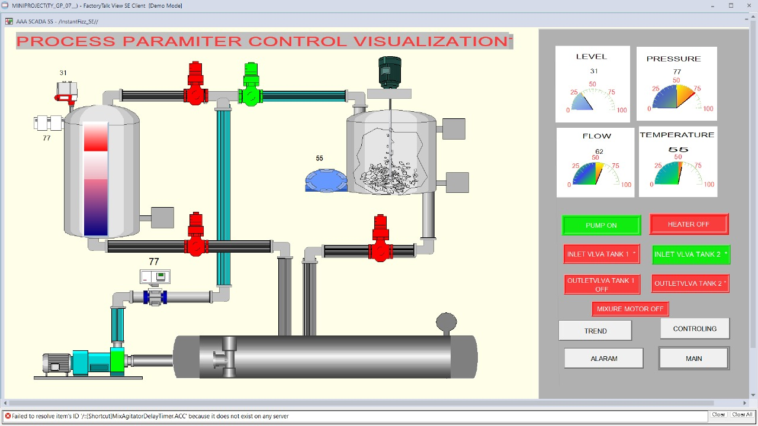
Results

Slide 6
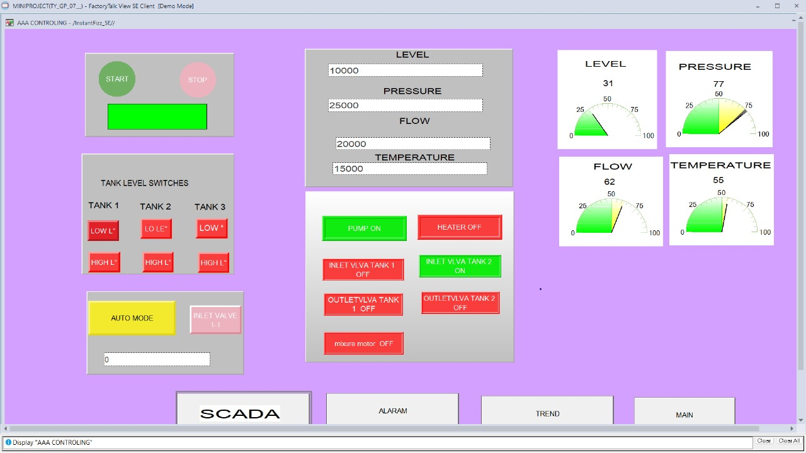

Slide 7
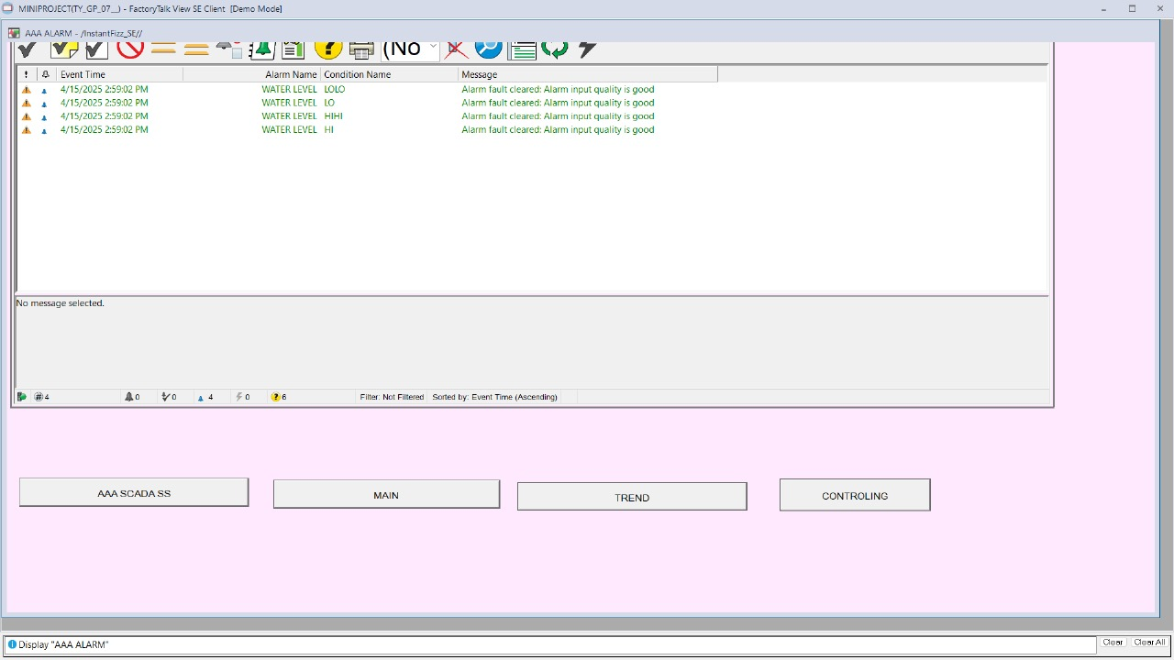
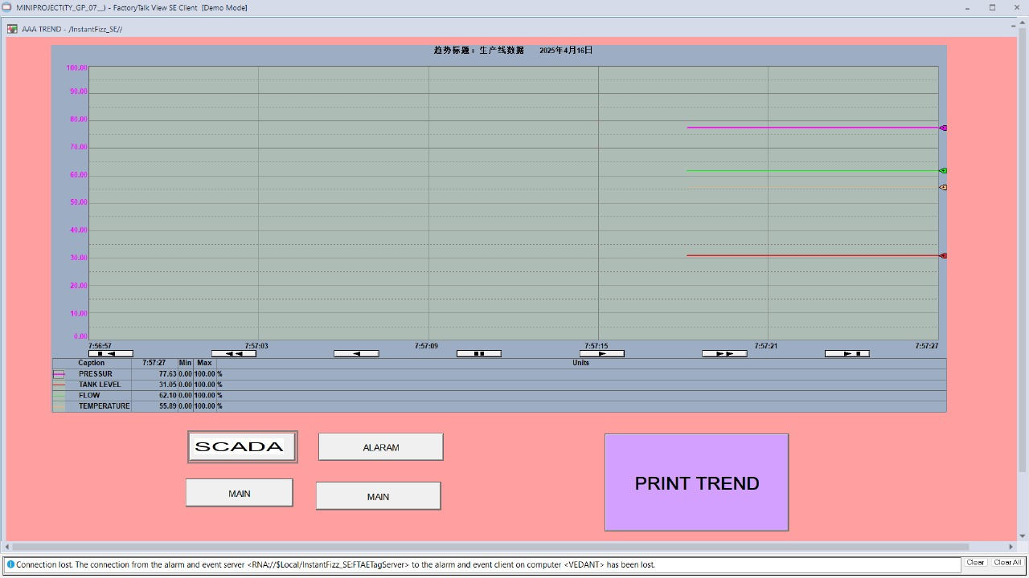

Slide 8
Advantages
1. Real-time Monitoring and Control: The system allows continuous monitoring of process parameters like level, pressure, flow, and temperature via SCADA.
Operators can remotely control pumps and valves, improving safety and responsiveness.
2. Improved Process Efficiency: Automated start/stop logic for pumps and valves based on level and flow conditions reduces manual intervention.
Optimized control helps maintain consistent product quality and reduces downtime.
3. Enhanced Safety: Use of High-Level (LSH) and Low-Level (LSL) switches prevents overfilling or dry-run conditions.
Pressure Relief Valve (PRV) and alarm logic protect equipment and personnel from hazardous overpressure situations.
4. Energy and Resource Savings: Pumps and valves operate only when necessary, minimizing energy consumption.
Controlled flow and level management reduce water or chemical wastage.
5. Scalable and Modular Design: The system can be easily expanded by adding more sensors, tanks, or processes.
Suitable for industrial applications like chemical processing, water treatment, and oil refineries.
6.Centralized Data Logging and Analysis: SCADA enables logging of real-time data for trend analysis and performance review.
Helps in predictive maintenance and decision-making based on historical data.
7. User-Friendly Interface: Graphical SCADA screens with process mimic diagrams offer intuitive operation.
Visual alarms and indicators make fault detection faster and easier.

Slide 9
Applications
Chemical Processing Industries
Food and Beverage Industry
Oil and Gas Sector
Building Automation Systems
Educational and Research Projects

Slide 10
Future Scope
The Scada Design for Process Parameter has strong potential for real-world implementation:
Hardware Integration: Move from simulation to physical PLCs and sensors
IoT & Cloud: Enable remote monitoring and cloud data analytics
Wireless Sensing: Add edge computing for mobile/remote use
Machine Learning: Predict faults and auto-tune PID controls
Advanced Strategies: Use fuzzy logic, MPC, neural networks
Additional Parameters: Include pH, turbidity, chemical dosing
Training Modules: Create academic and industrial content
Cybersecurity: Secure data with protocols and real-time alerts
Scalability: Modular design for large-scale setups
Industry 4.0 Ready: Supports smart, adaptive process automation

Slide 11
Conclusion
The Scada Design for Process Parameter successfully demonstrates the design and simulation of a basic process control and monitoring system using PLC and SCADA technologies. It focuses on key industrial parameters such as flow, level, temperature, and pressure, integrating sensors, actuators, and control logic to replicate real-world conditions within a virtual environment.
The project highlights the importance of automation in ensuring operational safety, efficiency, and fault detection in process industries. By simulating practical scenarios like overpressure, overflow, and abnormal flow, the system provides a valuable platform for understanding the fundamentals of industrial automation and process control.
Although the current version operates entirely in a simulated environment and uses fundamental control logic, it lays the groundwork for future enhancements, including hardware integration and more advanced control mechanisms. Overall, this design serves as an effective educational and training tool, bridging theoretical knowledge with hands-on application in industrial automation.

Slide 12
References
[1] S. Phuyal, D. Bista, J. Izykowski, and R. Bista, "Design and implementation of cost efficient SCADA system for industrial automation," Int. J. Eng. Manuf., vol. 10, no. 2, pp. 15–28, Apr. 2020, DOI: 10.5815/ijem.2020.02.02.
[2] T. S. Amosun and W. O. Adedeji, "Design of a PLC based temperature controlled system," REM J. Rekayasa Energi Manufakt., vol. 8, no. 2, pp. 93–100, Dec. 2023, DOI: 10.21070/r.e.m.v8i2.1683.
[3] A. Archana and B. Yadav, "PLC & SCADA based automation of filter house, a section of Water Treatment Plant," in Proc. 2012 1st Int. Conf. Emerg. Technol. Trends Electron., Commun. Netw. (ET2ECN), Bhopal, India, Dec. 19–21, 2012, pp. 1–6, DOI: 10.1109/ET2ECN.2012.6470057.
[4] D. Engin, M. Engin, S. Pınar, and M. Candan, "PLC and SCADA based real-time monitoring and control of networked processes," J. Multidiscip. Eng. Sci. Technol. (JMEST), vol. 8, no. 6, pp. 14070–14080, Jun. 2021.

Slide 13

Thank You

